Slide 1
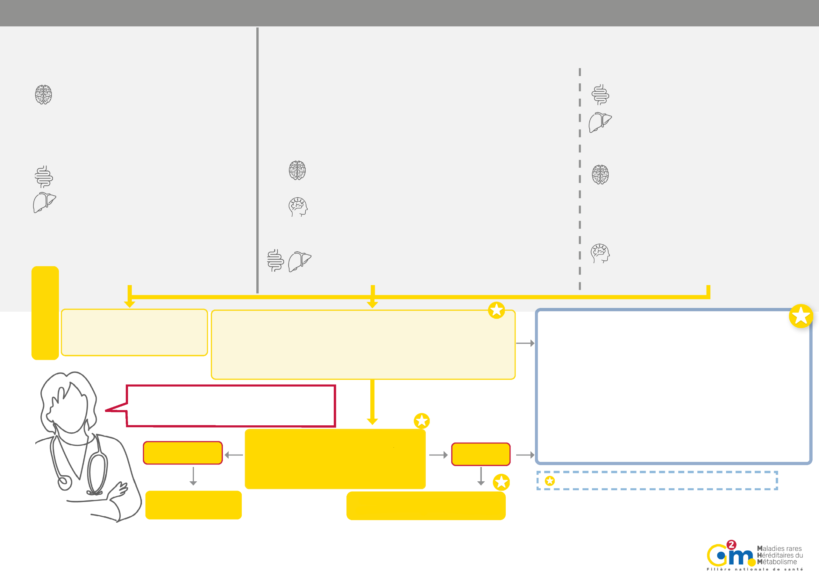
WHEN TO CONSIDER PRIMARY UREA CYCLE DISORDER
NEONATES
ACUTE ONSET
From 24 to 72 hours of life
SYMPTOM-FREE INTERVAL
INFANTS, CHILDREN, ADOLESCENTS, ADULTS:
ONSET REVEALED BY ACUTE ATTACK OR CHRONIC ILLNESS, BOTH TYPES ARE OFTEN ASSOCIATED
Association and severity of symptoms vary depending on patients
ACUTE LATE ONSET
Paroxysmal episodes (metabolic decompensation)
Triggering factors: infections, fever, anorexia, vomiting, diarrhoea, excessive protein intake, fasting, insufficient calorie intake, catabolism, surgery, weight loss
Risk of multiorgan failure, death or severe disability during decompensation
Neurological impairment
Impaired consciousness, up to coma ± convulsions Hyper or hypoventilation, Pyramidal syndrome
Psychiatric disorders
Hallucinations, paranoia, manic episodes, emotional disorders, personality changes, post-partum psychosis
Digestive and liver impairment
Vomiting / Nausea / Anorexia
Cytolysis / Liver failure / Reye Syndrome
CHRONIC PRESENTATION
Digestive and liver impairment
Chronic vomiting and anorexia
Aversion to protein
Growth retardation
Hepatomegaly
Cholestasis in some deficiencies
Neurological impairment
Learning disabilities
Intellectual disability
Headaches
Tremors, ataxia, dysarthria
Progressive spastic diplegia or quadriplegia
Psychiatric disorders
Hyperactivity,
Mood and behavioural disorders and autistic spectrum disorders
Rapidly-worsening neurological impairment
Impaired consciousness up to coma
± convulsions
Hyper or hypoventilation
Axial hypotonia, peripheral hypertonia
Digestive and liver impairment
Vomiting / Nausea / Anorexia Cytolysis / Liver failure
Other
Peripheral circulation disorders
Temperature instability
Clinical signs
Additional tests
Non-specialist laboratory workup
Possible: cytolysis, cholestasis, hepatocellular insufficiency, hypokalaemia
Standard metabolic assessment¹
HYPERAMMONAEMIA ² + initial alkalosis then +/- acidosis
Hyperammonaemia = ammonia levels above the norm:
Norm: Neonate ammonia < 100 µmol/L, Non-neonate ammonia < 50 µmol/L
Severe hyperammonaemia
if >200 µmol/L (Neonates, infants)/>150 umol/l (children and adults)
Urgent specialist advice from Centre of Excellence: Rare Disease Centre of Reference / Competence, as soon as the results of the standard metabolic assessment are received: https://www.filiere-a2m.fr/annuaire/
Start the parallel treatment urgently: Refer to the emergency protocols for each symptom and/or disease: https://www.filiere-g2m.fr/urgences
Specialist treatment coordinated by a Centre of Excellence
Genetic counselling, family screening in a specialist centre
For more information : PNDS: French National Authority for Health - Urea Cycle Disorders (has-sante.fr)
Urea cycle disorder?
Specialist workup
Specialist metabolic assessment³
Plasma: amino acid chromatography
acylcarnitine profile
Urine: orotic acid levels, organic acid chromatography
No specific anomalies
Telltale abnormalities
Specialist medical opinion and reference laboratory
Secondary causes of hyperammonaemia ⁴
Confirmatory genetic analysis to be carried out subsequently by a specialist centre
¹ Standard metabolic assessment - Blood: ammonia levels, blood gases, blood sugar, lactates, ketosis test (urine dipstick test and/or capillary blood ketones). To be performed immediately where there is no obvious cause, at the same time as looking for other causes: sepsis (neonates), brain damage: trauma-related, vascular, infection-related, encephalitis etc., drug toxicity, other metabolic diseases. Refer to the emergency protocol for coma
² Pay attention to sample-taking conditions. Always perform tests but do not necessarily wait for test results to start treatment. Ammonia level norms may vary depending on the laboratory.
The severity and impact of hyperammonaemia may vary depending on age and/or presentation type. Treat severe cases of Hyperammonaemia in intensive care.
³It is important to take samples during the acute phase, and as soon as possible, ideally before starting any treatment, though this should not be delayed.
The samples that are essential for diagnosis are in bold, while the others may be useful to interpret the metabolic assessment and eliminate certain differential diagnoses.
⁴ Hepatocellular insufficiency, drugs (valproate,etc.), portosystemic shunts (portocaval shunts, some infections including bacterial urease in urine +, some tumours, etc.), others (severe malnutrition, etc.).

